Slide 1
Regression
Md. Ismail Hossain Riday

Slide 2
Regression
In the previous class, we covered the concept of "correlation," which helps us measure the relationship between two variables, denoted as "x" and "y”.
A positive correlation implies that as "x" increases, "y" also increases, or vice versa.
However, determining which variable is influencing the other is challenging.

Slide 3
Regression
Relationship between two or more variables
Cause and effect relationship
Causal variables vs Affected variables
Causal variables as independent variables; affected variables as dependent variables

Slide 4
Regression
Relationship between two or more variables
Cause and effect relationship
Causal variables vs Affected variables
Causal variables as independent variables; affected variables as dependent variables

Slide 5


Regression
$$Dependent variable = Y$$
$$Independent variable =X$$
Regression refers to the cause-and-effect relationship between two or more variables, where affected variables are dependent variables and causal variables are independent variables.
This relationship is mathematically expressed, highlighting the impact of independent variables on dependent variables.

Slide 6
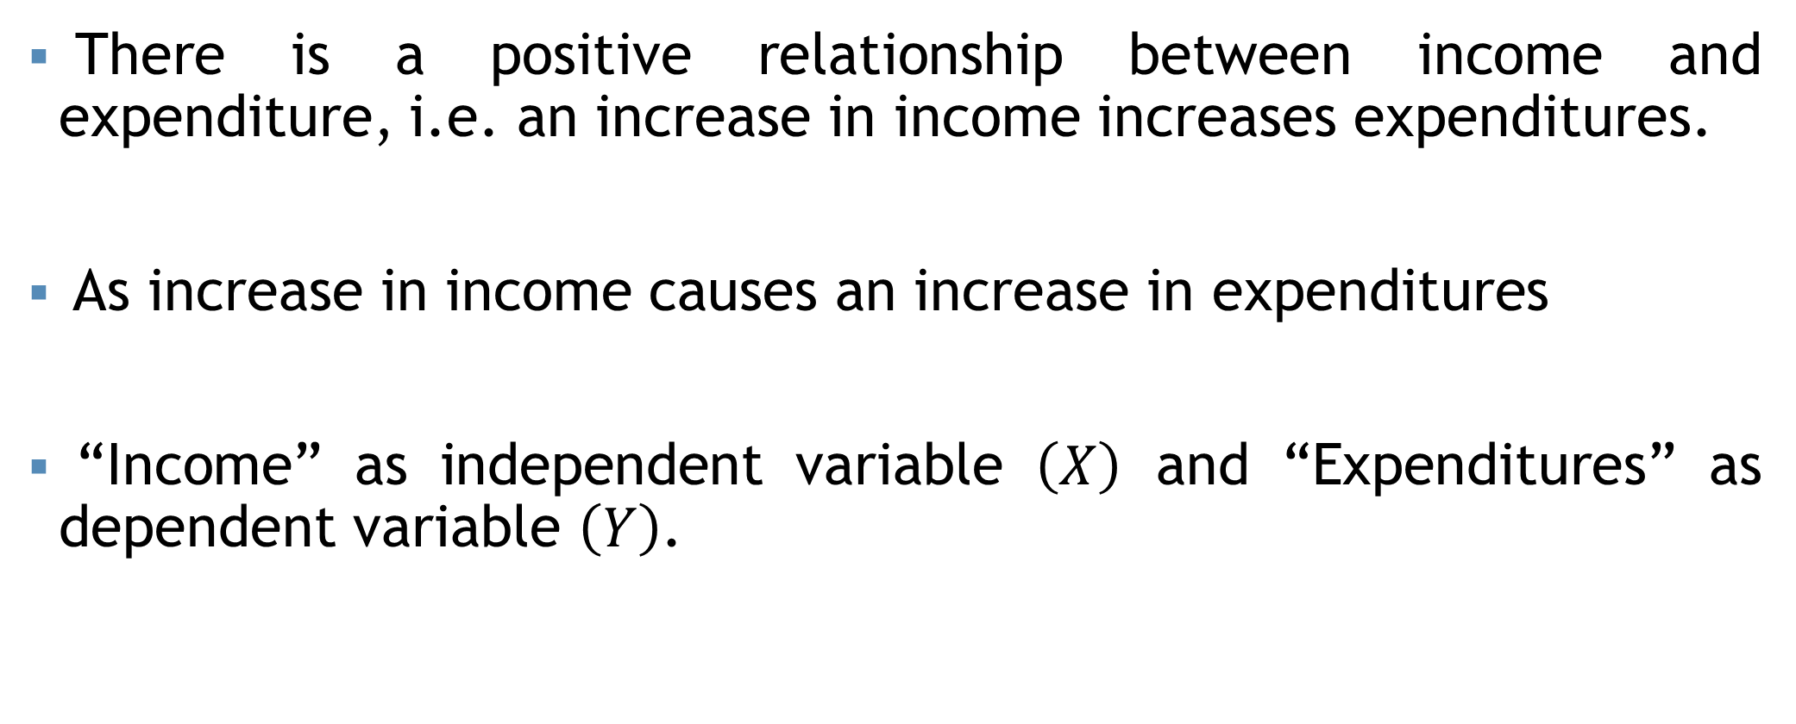
Regression
There is a positive relationship between income and expenditure, i.e. an increase in income increases expenditures.
As increase in income causes an increase in expenditures
“Income” as independent variable $\left(X\right)$ and “Expenditures” as dependent variable $\left(Y\right)$.

Slide 7
Correlation vs Regression
Correlation | Regression
1. Correlation is a statistical measure that determines the association between two variables. | 1. Regression describe how to numerically relate an independent variable to the dependent variable.
2. There is no dependent variable and independent variable. | 2. Must be one dependent variable and one independent variable.
3. To represent the linear relationship between variables. | 3. To represent the cause and effect relationship between variables.

Slide 8
Types of Regression
On the basis of variables

Slide 9
Types of Regression
On the basis of variables (two types)
Simple regression
One dependent vs one independent
Multiple regression
One dependent vs multiple independent

Slide 10
Types of Regression
On the basis of variables (two types)
Simple regression
One dependent vs one independent
Multiple regression
One dependent vs multiple independent

Slide 11
Types of Regression
On the basis of variables (two types)
Simple regression
One dependent vs one independent
Multiple regression
One dependent vs multiple independent

Slide 12
Types of Regression
On the basis of variables (two types)
Simple regression
One dependent vs one independent
Multiple regression
One dependent vs multiple independent

Slide 13
Types of Regression
On the basis of variables (two types)
Simple regression
One dependent vs one independent
Multiple regression
One dependent vs multiple independent

Slide 14
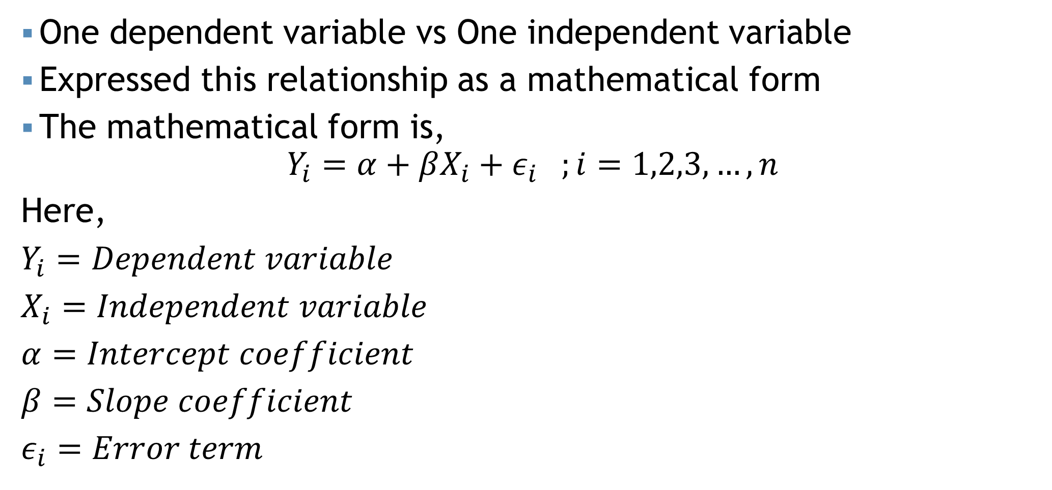
Simple regression
One dependent variable vs One independent variable
Expressed this relationship as a mathematical form
The mathematical form is,
$$Y_{i}=α+βX_{i}+ε_{i} ;i=1,2,3,…,n$$
Here,
$Y_{i}=Dependent variable$
$X_{i}=Independent variable$
$α=Intercept coefficient$
$β=Slope coefficient$
$ε_{i}=Error term$
Multiple regression: $Y=α+β_{1}X_{1}+…+β_{k}X_{k}+ε$

Slide 15
Simple regression

Slide 16

Simple regression
$$Y_{i}=α+βX_{i}+ε_{i}$$

Slide 17
Simple regression
$$Y_{i}=α+βX_{i}+ε_{i}$$

Slide 18
Simple regression
$$Y_{i}=α+βX_{i}+ε_{i}$$

Slide 19
Simple regression
$$Y_{i}=α+βX_{i}+ε_{i}$$
Error term

Slide 20
Simple regression
$$Y_{i}=α+βX_{i}+ε_{i}$$
Error term
Regression parameter

Slide 21
Estimating parameters
Estimating regression parameters:
Least Square Method
Graphical Method

Slide 22
Estimating parameters

Slide 23
Estimating parameters

Slide 24
Estimating parameters

Slide 25
Estimating parameters

Slide 26
Estimating parameters

Slide 27
Estimating parameters
Error term

Slide 28

Estimating parameters
$$Y_{i}=α+βX_{i}+ε_{i}$$
Let the estimator of $α$ and $β$ is $\hat{α}$ and $\hat{β}$.
$\hat{β}=\frac{\sum{\left(x_{i}−\overline{x}\right)\left(y_{i}−\overline{y}\right)}}{\sum{{\left(x_{i}−\overline{x}\right)}^{2}}}=\frac{n\sum{x_{i}y_{i}}−\sum{x_{i}\sum{y_{i}}}}{n\sum{x_{i}^{2}}−{\left(\sum{x_{i}}\right)}^{2}}$
$\hat{α}=\overline{y}−\hat{β}\overline{x}$

Slide 29

Estimating parameters
Let the estimator of $α$ and $β$ is $\hat{α}$ and $\hat{β}$.
$\hat{β}=\frac{\sum{\left(x_{i}−\overline{x}\right)\left(y_{i}−\overline{y}\right)}}{\sum{{\left(x_{i}−\overline{x}\right)}^{2}}}=\frac{n\sum{x_{i}y_{i}}−\sum{x_{i}\sum{y_{i}}}}{n\sum{x_{i}^{2}}−{\left(\sum{x_{i}}\right)}^{2}}$
$\hat{α}=\overline{y}−\hat{β}\overline{x}$
$$\hat{Y_{i}}=\hat{α}+\hat{β}X_{i}$$

Slide 30
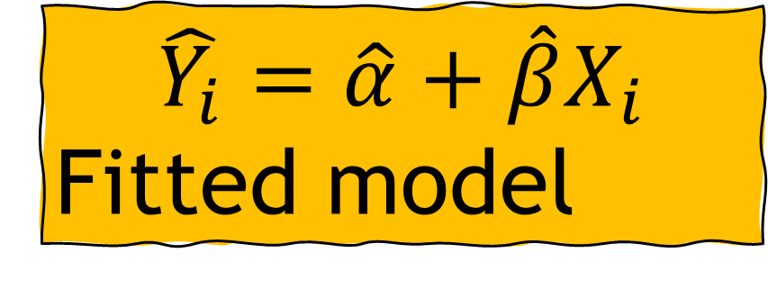
Estimating parameters
Let the estimator of $α$ and $β$ is $\hat{α}$ and $\hat{β}$.
$\hat{β}=\frac{\sum{\left(x_{i}−\overline{x}\right)\left(y_{i}−\overline{y}\right)}}{\sum{{\left(x_{i}−\overline{x}\right)}^{2}}}=\frac{n\sum{x_{i}y_{i}}−\sum{x_{i}\sum{y_{i}}}}{n\sum{x_{i}^{2}}−{\left(\sum{x_{i}}\right)}^{2}}$
$\hat{α}=\overline{y}−\hat{β}\overline{x}$
$$\hat{Y_{i}}=\hat{α}+\hat{β}X_{i}$$
Fitted model

Slide 31

Example
Advertising cost ($ million) | Sales revenue ($ million)
2 | 7
1 | 3
3 | 8
4 | 10
Draw the scatter diagram.
Determine the fitted regression model of sales revenue on advertising cost.
Interpret the regression parameter.
Estimate sales revenue when advertising cost is $9.
$$\hat{Y_{i}}=\hat{α}+\hat{β}X_{i}$$

Slide 32
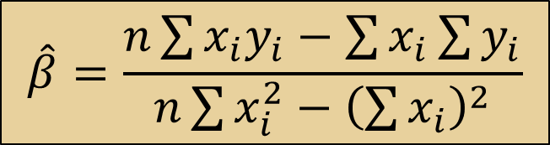
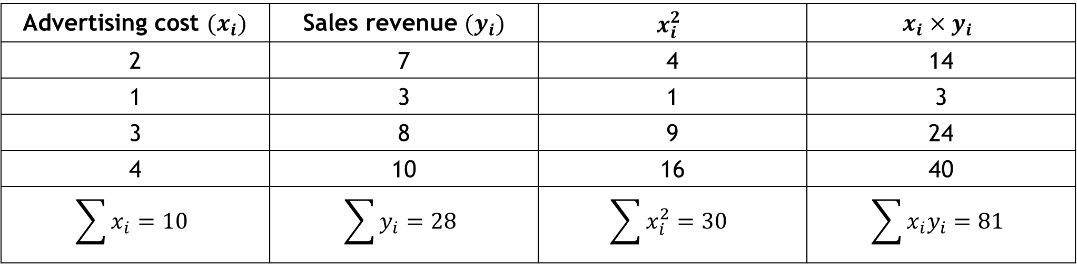
Example
$$\hat{β}=\frac{n\sum{x_{i}y_{i}}−\sum{x_{i}\sum{y_{i}}}}{n\sum{x_{i}^{2}}−{\left(\sum{x_{i}}\right)}^{2}}$$
Advertising cost $(x_{i})$ | Sales revenue $(y_{i})$ | $$x_{i}^{2}$$ | $$x_{i}×y_{i}$$
2 | 7 | 4 | 14
1 | 3 | 1 | 3
3 | 8 | 9 | 24
4 | 10 | 16 | 40
$$\sum{x_{i}}=10$$ | $$\sum{y_{i}}=28$$ | $$\sum{x_{i}^{2}}=30$$ | $$\sum{x_{i}y_{i}=81}$$

Slide 33
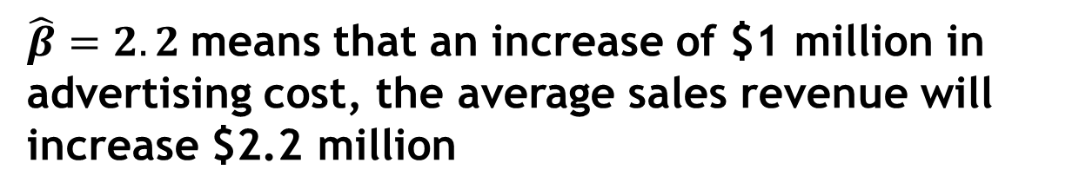
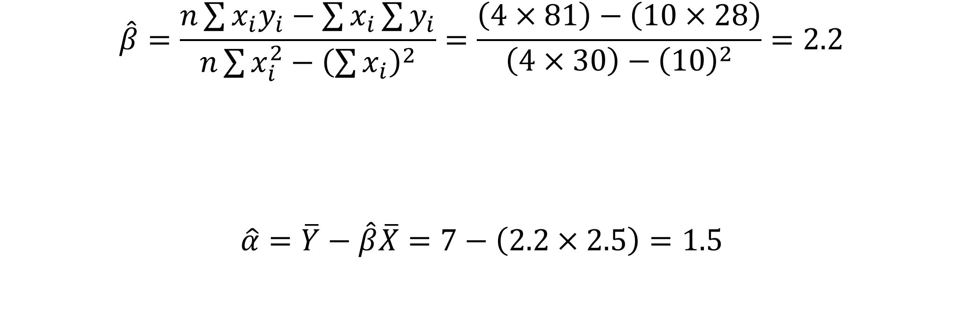
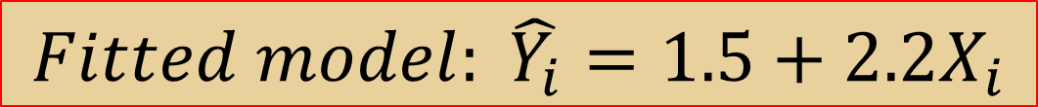
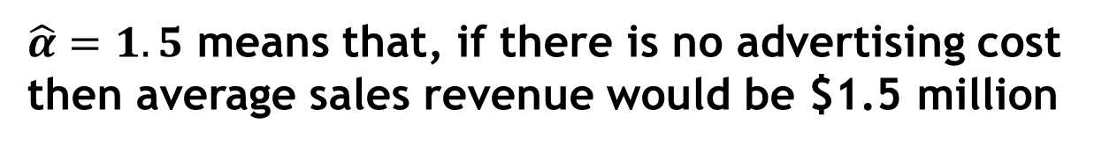
Example
$$Fitted model: \hat{Y_{i}}=1.5+2.2X_{i}$$
$$If X=9: \hat{Y_{i}}=1.5+2.2×9=21.3$$
$$\hat{β}=\frac{n\sum{x_{i}y_{i}}−\sum{x_{i}\sum{y_{i}}}}{n\sum{x_{i}^{2}}−{\left(\sum{x_{i}}\right)}^{2}}=\frac{\left(4×81\right)−\left(10×28\right)}{\left(4×30\right)−{\left(10\right)}^{2}}=2.2$$
$$\hat{α}=\overline{Y}−\hat{β}\overline{X}=7−\left(2.2×2.5\right)=1.5$$
$\hat{β}=2.2$means that an increase of $1 million in advertising cost, the average sales revenue will increase $2.2 million
$\hat{α}=1.5$ means that, if there is no advertising cost then average sales revenue would be $1.5 million

Slide 34
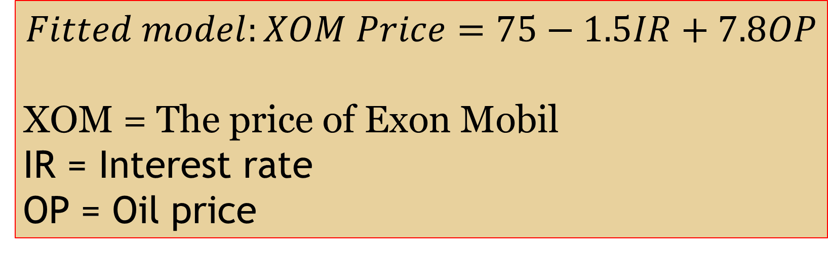
Example
$$Fitted model:XOM Price=75−1.5IR+7.8OP$$
XOM = The price of Exon Mobil
IR = Interest rate
OP = Oil price
If other variables are held constant, the price of XOM will decrease by 1.5 unit if the price of oil in the markets increases by 1 unit.
If other variables are held constant, the price of XOM will increase by 7.8 unit if the price of oil in the markets increases by 1 unit.

Slide 35


Self practice
Investment | 5 | 10 | 15 | 20 | 25
Profit | 3 | 4 | 8 | 12 | 18
Estimate linear regression line of profit on investment
$$Y$$
$$X$$

Slide 36
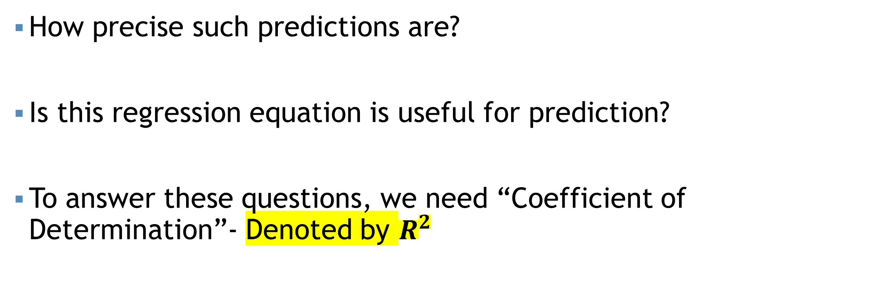
Goodness of Fit
$$If X=9: \hat{Y_{i}}=1.5+2.2×9=21.3$$
How precise such predictions are?
Is this regression equation is useful for prediction?
To answer these questions, we need “Coefficient of Determination”- Denoted by $R^{2}$

Slide 37
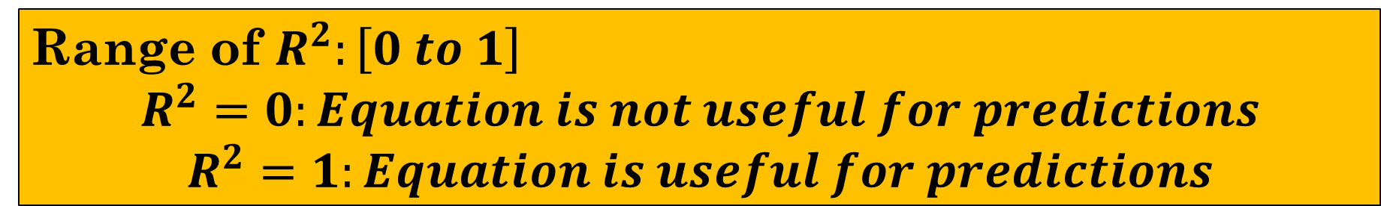
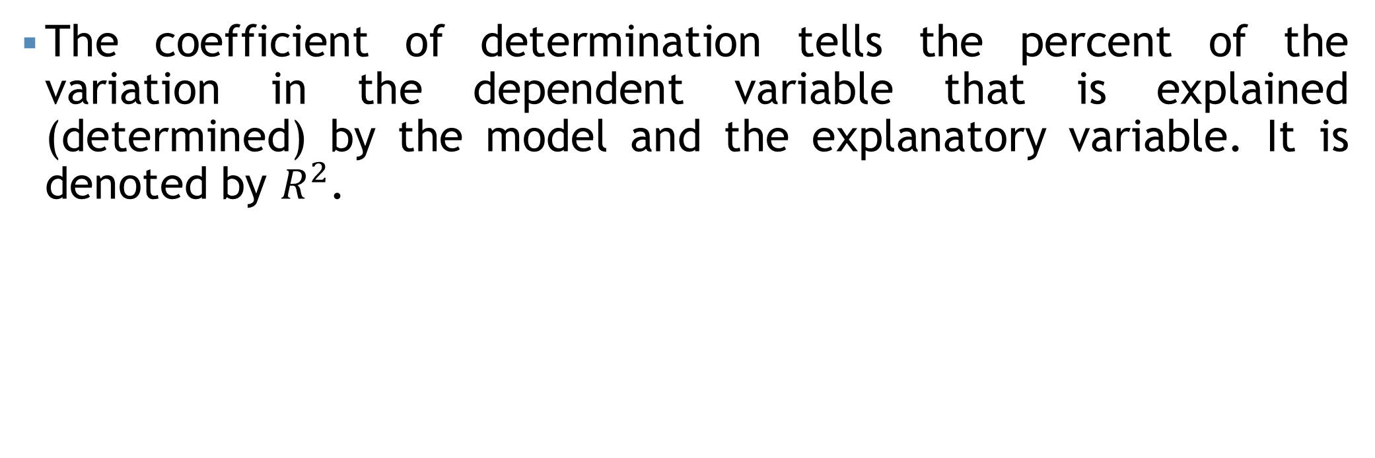
Coefficient of determination
The coefficient of determination tells the percent of the variation in the dependent variable that is explained (determined) by the model and the explanatory variable. It is denoted by $R^{2}$.
Range of $R^{2}:\left[0 to 1\right]$
$$R^{2}=0:Equation is not useful for predictions$$
$$R^{2}=1:Equation is useful for predictions$$

Slide 38
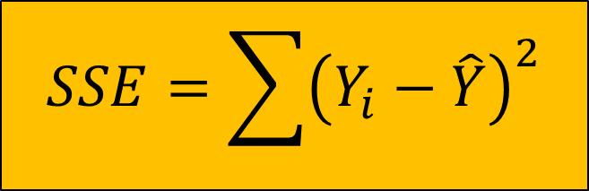
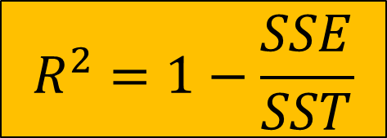
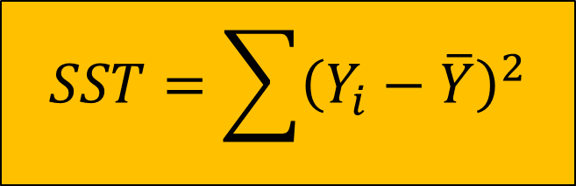
Coefficient of determination
$$SSE=\sum{{\left(Y_{i}−\hat{Y}\right)}^{2}}$$
SSE = Error Sum of Square
$$R^{2}=1−\frac{SSE}{SST}$$
SST = Total Sum of Square
$$SST=\sum{{\left(Y_{i}−\overline{Y}\right)}^{2}}$$

Slide 39
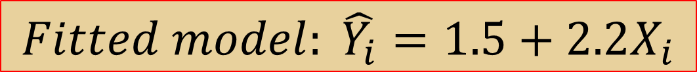
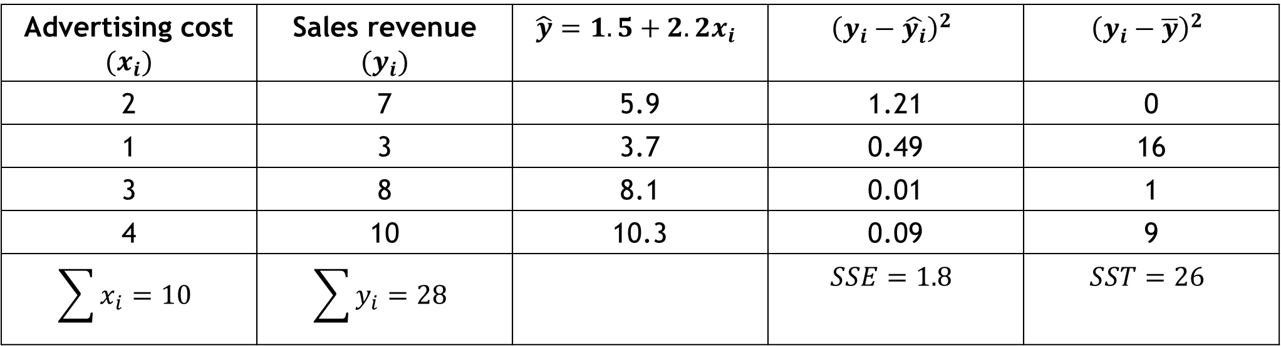

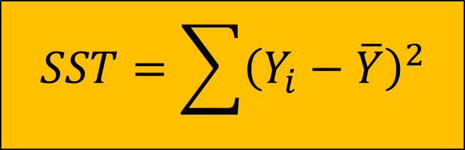
Coefficient of determination
$$Fitted model: \hat{Y_{i}}=1.5+2.2X_{i}$$
Advertising cost $(x_{i})$ | Sales revenue $(y_{i})$ | $$\hat{y}=1.5+2.2x_{i}$$ | $${\left(y_{i}−\hat{y_{i}}\right)}^{2}$$ | $${\left(y_{i}−\overline{y}\right)}^{2}$$
2 | 7 | 5.9 | 1.21 | 0
1 | 3 | 3.7 | 0.49 | 16
3 | 8 | 8.1 | 0.01 | 1
4 | 10 | 10.3 | 0.09 | 9
$$\sum{x_{i}}=10$$ | $$\sum{y_{i}}=28$$ |  | $$SSE=1.8$$ | $$SST=26$$
$$SSE=\sum{{\left(Y_{i}−\hat{Y}\right)}^{2}}$$
$$SST=\sum{{\left(Y_{i}−\overline{Y}\right)}^{2}}$$

Slide 40
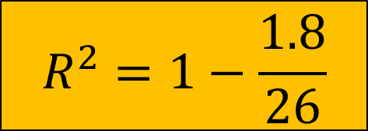
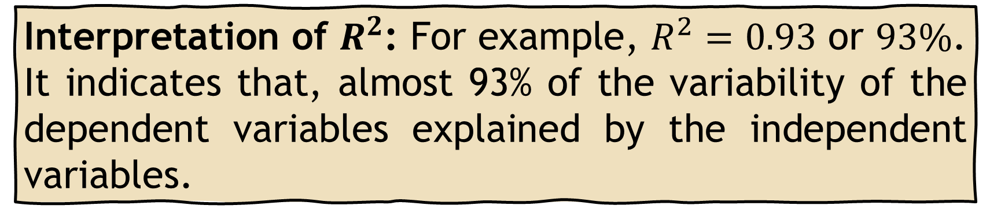

Coefficient of determination
$$R^{2}=1−\frac{SSE}{SST}$$
$$R^{2}=1−\frac{1.8}{26}$$
$$R^{2}=0.93$$
Interpretation of $R^{2}$: For example, $R^{2}=0.93$ or $93\%$. It indicates that, almost 93% of the variability of the dependent variables explained by the independent variables.

Slide 41
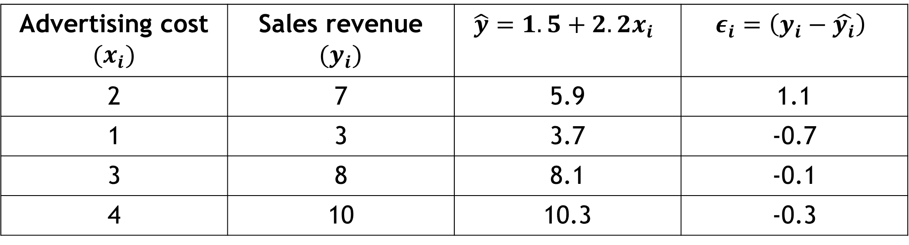
Error Calculation
$$Fitted model: \hat{Y_{i}}=1.5+2.2X_{i}$$
Advertising cost $(x_{i})$ | Sales revenue $(y_{i})$ | $$\hat{y}=1.5+2.2x_{i}$$ | $$ε_{i}=\left(y_{i}−\hat{y_{i}}\right)$$
2 | 7 | 5.9 | 1.1
1 | 3 | 3.7 | -0.7
3 | 8 | 8.1 | -0.1
4 | 10 | 10.3 | -0.3

Slide 42

Properties of Regression Coefficients
Regression coefficient has unit.
Regression coefficients are not symmetric function, $i.e., β_{yx}≠β_{xy}$

Slide 43
Self Practice
PCT = Project Completion Time
TS = Training Score
PCT: | 24 | 20 | 28 | 18 | 22 | 15 | 30 | 25
TS: | 65 | 78 | 82 | 92 | 88 | 95 | 75 | 80
Calculate correlation coefficient with proper interpretation
Estimate the liner regression model of project completion time on training score. Interpret the regression parameter.
Predict the project completion time if the training score is 55.
How accurate your prediction?
Suppose you found a mistake in the training score for the 2nd employee after fitting the model. The correct score is 88. Now Calculate the corrected regression parameter.

Slide 44
Thank You

